Slide 1
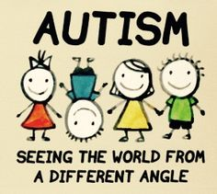
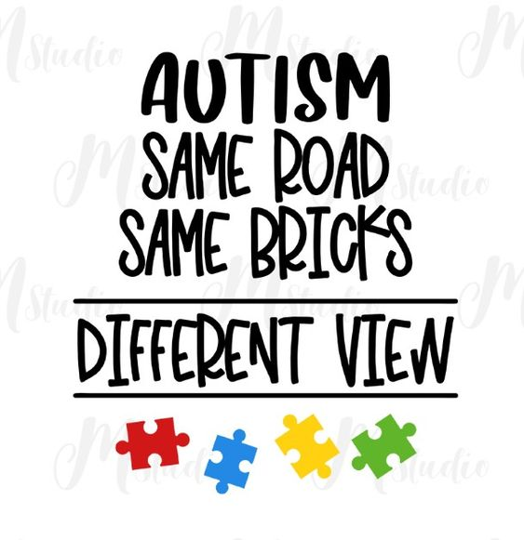
Outline
Abstract
Introduction
Existing System
Proposed System
Literature Survey
Issues / Challenges
Problem Statement
Objectives of Project
Proposed Methodology
System Requirements
Design Diagrams and Algorithms
Modules Planned and Implemented
References

Slide 2
Abstract
This project focuses on developing an Autism Spectrum Disorder (ASD) prediction model employing a combination of Machine Learning (ML) and Deep Learning (DL) techniques.
The study leverages a diverse dataset comprising individuals across various age groups, categorizing them into four distinct groups: infants (0-3 years old), children (4-12 years old) and elderly individuals (11 years and older).
The core innovation lies in the utilization of Convolutional Neural Network (CNN) based visual autistic detection algorithms tailored for each age group.
Through meticulous training and evaluation, this research endeavors to deliver accurate and age-specific predictive models for ASD, thereby contributing significantly to early intervention and personalized care strategies for individuals on the autism spectrum

Slide 3
Introduction
Autism Spectrum Disorder (ASD) represents a complex neurodevelopmental condition characterized by a range of challenges in social interaction, communication, and behavior.
Early diagnosis and intervention play a pivotal role in improving the quality of life for individuals with ASD. In recent years, advancements in Machine Learning (ML) and Deep Learning (DL) have shown remarkable promise in automating the process of ASD detection.
This project aims to harness the potential of these technologies to develop a robust predictive model for ASD across diverse age groups, ranging from infants to the elderly.
By employing a multifaceted approach that includes both ML and DL techniques, this research endeavors to enhance the accuracy and specificity of ASD prediction.
The unique characteristic of this project lies in its segmentation of the dataset according to age groups: infants (0-3 years old), children (4-12 years old), adolescents (13-18 years old), and elderly individuals (65 years and older).
Moreover, by tailoring Convolutional Neural Network (CNN) based visual detection algorithms for each demographic, this study seeks to address the challenge of age-specific ASD prediction, a critical aspect often overlooked in existing research.

Slide 4
Existing System
The existing system for ASD prediction primarily relies on clinical assessments conducted by trained professionals, which often involve interviews, questionnaires, and observations.
However, this approach has several limitations, including subjectivity, time-consuming procedures, and the potential for human error. Additionally, the current system may not always detect subtle early signs of ASD, particularly in very young children.
While some research has explored the application of machine learning in ASD prediction, it often focuses on specific age groups or relies solely on behavioral analysis, overlooking the potential of incorporating image-based classification.

Slide 5
Proposed System
The proposed system integrates state-of-the-art machine learning models and deep learning techniques to create a comprehensive Autism Spectrum Disorder (ASD) prediction platform.
First, a behavioral analysis module designed to process data from children aged 0 to 3 years, employing machine learning algorithms to detect subtle behavioral cues indicative of ASD.
Second, a parallel behavioral analysis module will be implemented to cater to individuals aged 4 to elderly, fine-tuning the analysis process to accommodate the unique characteristics of different age groups.
Third, an image-based classification system utilizing Convolutional Neural Networks (CNNs) will be incorporated, enabling the extraction of visual features for accurate ASD classification. These components will work synergistically, providing a comprehensive and adaptable toolset for early ASD detection across diverse demographics.

Slide 6
Literature Survey
Sl No | Paper Name | Authors | Contributions | Drawbacks
1 | Autism Assistant: A Platform for Autism Home-Based Therapeutic Intervention | Mihaela chistol, Cristina turcu and Mirela danubianu(IEEE-2023) | A study aimed to create educational software for home-based therapeutic interventions for Romanian children with Autism Spectrum Disorder (ASD). Employing the Double Diamond Model and Human-Centered Design methodology, the software prioritizes end-users' special needs, incorporating proto-personas, wireframes, and interactive prototypes. . | The development of new modules for adolescents and young people with autism is required. These modules aim to enhance communication skills and interpersonal relationships by simulating real-life scenarios in a virtual environment using virtual reality technologies
2 | A Virtual Reality Based System for the Screening and Classification of Autism | Marta Robles, NegarNamdarian, Julia Otto(IEEE-2022) | A system to support the screening of Autism Spectrum Disorders based on a virtual reality social interaction, namely a shopping experience, with an embodied agent | future research should also aim to clinically validate the presented screening tool, pursuing to classify the severity of the disorder.

Slide 7
Sl No | Paper Name | Authors | Contributions | Drawbacks
3 | Predicting the Symptom Severity in Autism Spectrum Disorder Based on EEG Metrics | Yangsong Zhang , Shu Zhang, Baodan Chen (IEEE – 2022) | The aim is to investigate whether the ASD symptom severity could be predicted with electroencephalography (EEG) metrics. Based on a publicly available dataset, the EEG brain networks were constructed, and four types of EEG metrics were calculated.Then, we statistically compared the brain network differences among ASD children | The nonliner methods as the deep neural network should be introduced to provide more accurate prediction results.
4 | A Transdiagnostic Biotype Detection Method for Schizophrenia and Autism Spectrum Disorder Based on Graph Kernel | Yuhui Du, Hui Hao, Ying Xing, Ju Niu, Vince D Calhoun (IEEE - 2021) | Graph kernel-based clustering method to explore transdiagnostic biotypes using FC estimated from functional magnetic resonance imaging (fMRI) data | Lacks automatic parameter selection for the biotype detection
5 | An Immersive Computer-Mediated Caregiver-Child Interaction System for Young Children With Autism Spectrum Disorder | Guangtao Nie,Akshith Ullal, Zhi Zheng (IEEE-2021) | The first autonomous system designed for teaching IJA skills to children with ASD incorporating caregivers within the loop to enhance the potential for generalization in real-world. | In order to address the aforementioned limitations, in the future, they plan to conduct randomized controlled trials with larger sample sizes.

Slide 8
A | Paper Name | Authors | Contributions | Drawbacks
6 | Design of an Interactive Virtual Reality System, InViRS, for Joint Attention Practice in Autistic Children | Ashwaq Z. Amat,Huan Zhao , Amy Swanson(IEEE-2021) | A novel virtual reality (VR)-based system, called InViRS, in which children with ASD play games allowing them to practice gaze sharing. | InViRS as a system is capable of tracking game data in varying configurations, accumulating game performance measures, adaptively changing the difficulty level while simultaneously interacting with participants and providing real-time feedback
7 | A Novel Grading System for Autism Severity Level Using Task-Based Functional MRI: A Response to Speech Study | Reem Haweel, Ahmed M. Shalaby, Ali H. Mahmoud, Mohammed Ghazal(IEEE - 2021) | a novel computer-aided grading framework in infants and toddlers (between 12 and 40 months) dependent on the analysis of brain activation in response to a speech experiment | Failed to individually assess the biology of the patient in clinic, anticipate phenotypes, and more importantly prescribe personalized treatments/medicines.
8 | Computer Aided Autism Diagnosis Using Diffusion Tensor Imaging | Yaser A. Elnakieb , Mohamed T. Ali, Ahmed Soliman ,Ali H. Mahmoud(IEEE – 2020) | Automated computer aided diagnostic (CAD) system for accurate identification of autism spectrum disorder based on the connectivity of the white matter (WM) tracts | Fails CAD implementation which will be used to incorporate different imaging modalities, such as structural or functional MRI.

Slide 9
Sl No | Paper Name | Authors | Contributions | Drawbacks
9 | Assessment of Speech and Fine Motor Coordination in Children With Autism | Tanya Talkar,james R. Williamson , Daniel J. Hannon(IEEE – 2020) | correlations of acoustic, video, and handwriting time-series derived from five children with ASD and five children with neurotypical development during speech and handwriting tasks was computed. | Required to work with clinicians to map any insights about lower or higher complexity in speech and handwriting features to existing interventions.
10 | Estimating Autism Severity in Young Children From Speech Signals Using a Deep Neural Network | Marina Eni, Ilan Dinstein, Michal Ilan(IEEE – 2020) | A variety of prosodic, acoustic, and conversational features from speech recordings of Hebrew speaking children who completed an Autism Diagnostic Observation Schedule (ADOS) assessment were extracted | The age of participating children was most strongly correlated with only few extracted features: vocalization rate, the duration of vocalizations, and the total number of vocalizations. Most acoustic and prosodic features were not significantly correlated with age

Slide 10
Challenges Of Existing System
Delayed diagnosis
Limited access to screening
Disparities in access
Waiting lists
Financial burden
Inadequate support in schools
Bullying and social isolation
Lack of transition planning
Limited vocational opportunities

Slide 11
Problem Statement
Autism Spectrum Disorder (ASD) presents significant challenges in social interaction, communication, and behavior regulation. Understanding the underlying causes and developing effective interventions to address these complexities is crucial for improving the quality of life for individuals with ASD and their families. Research aims to unravel the multifaceted nature of ASD, seeking innovative strategies for early detection, personalized treatment, and comprehensive support.

Slide 12
Objectives Of Project
1. To propose an autism prediction model using ML Techniques, that could effectively predict autism traits of an individual of any age group.
2. Learning the characteristics of children with autism.
3. Early identification of the stages of autism.
4. Different diagnosis methods.

Slide 13


Proposed Methodology
1.Data Collection and Preprocessing:
Behavioral Data (0-3 years): Acquire a diverse dataset containing behavioral information of infants and young children. This dataset will encompass a wide range of variables including social interactions, communication patterns, sensory sensitivities, and repetitive behaviors. Preprocess the data by cleaning, normalizing, and encoding categorical variables.
Behavioral Data (4-elderly): Obtain a separate dataset tailored to older age groups, capturing relevant behavioral markers specific to their demographic. Normalize and preprocess the data to ensure compatibility with the analysis framework.
Image Data: Develop a linear visual autistic detection system using YOLO by annotating a dataset of images or short video clips, fine tuning a pre trained YOLO model, implementing it for real-time analysis.

Slide 14
2. Feature Engineering:
For behavioral analysis, extract relevant features from the preprocessed datasets. These features may include measures of social engagement, communication frequencies, and specific behavioral patterns indicative of ASD.
In the case of image-based analysis, employ techniques like transfer learning with pre-trained CNN models or custom feature extraction to obtain discriminative visual features.
3.Model Development:
Behavioral Analysis (0-3 years and 4-elderly): Utilize machine learning algorithms such as Random Forests, Support Vector Machines, or Neural Networks to build predictive models. Train separate models for the 0-3 years and 4-elderly age groups to account for age-specific behavioral variations.
Image-Based Analysis: Implement a Convolutional Neural Network (CNN) architecture, fine-tuned for ASD classification. This CNN will be trained on the preprocessed image data, learning to discern visual cues associated with ASD.

Slide 15
4.Model Training and Validation:
Split the datasets into training, validation, and test sets to evaluate model performance. Employ cross-validation techniques to ensure robustness and mitigate overfitting.
5.Ensemble Learning (Optional):
Optionally, consider ensemble learning techniques to combine the predictions from the different models (behavioral analysis and image-based classification) for enhanced accuracy and reliability.
6.Model Evaluation:
Assess the models' performance using relevant metrics such as accuracy, precision, recall, and F1-score. Evaluate their ability to correctly identify ASD cases and non-ASD cases across all age groups.
7.Integration and User Interface:
Develop an intuitive user interface to facilitate seamless interaction with the prediction system. Integrate all components including data preprocessing, feature extraction, and model predictions into a cohesive framework.

Slide 16
8.Testing and Validation:
Conduct extensive testing to ensure the system's functionality, accuracy, and user-friendliness. Validate the predictions against established clinical assessments and benchmarks.
9.Deployment and Accessibility:
Make the prediction system accessible to healthcare professionals, caregivers, and individuals seeking ASD assessments. Provide user support and documentation for effective utilization.

Slide 17
Scope of the Project
This project endeavors to develop a versatile and robust Autism Spectrum Disorder (ASD) prediction system with a multi-dimensional approach.
It primarily encompasses three key components: early behavioral analysis for children aged 0 to 3 years, behavioral analysis for individuals from 4 years to elderly, and image-based autistic classification using Convolutional Neural Networks (CNNs).
The project's scope extends to the creation of machine learning models trained on comprehensive datasets, incorporating diverse behavioral markers and image data.
Additionally, the project aims to implement a user-friendly interface for easy accessibility by parents, caregivers, and healthcare professionals.
While the primary focus is on prediction and early intervention, the project's potential applications also include aiding in the development of tailored therapeutic interventions and facilitating research on ASD.
The system's scalability and adaptability will be considered to accommodate future refinements and extensions based on emerging technologies and research findings in the field of autism diagnosis and intervention.

Slide 18
System Requirements
HARDWARE REQUIREMENTS
The most common set of requirements defined by any operating system or software application
is the physical computer resources, also known as hardware.
Processor : >i3
Ram :4GB.
HardDisk : 500GB.
Inputdevice : Standard Keyboard and Mouse.
CompactDisk : 650Mb.
SOFTWARE REQUIREMENTS
Software requirements deal with defining software resource requirements and prerequisites that need to
be installed on a computer to provide optimal functioning of an application. The following are the
software requirements for the application:
OS: Windows 7 and above
Back end: Python 3.7.5
Front end: HTML, CSS
IDE: Jupyter Notebook,Google Colab

Slide 19
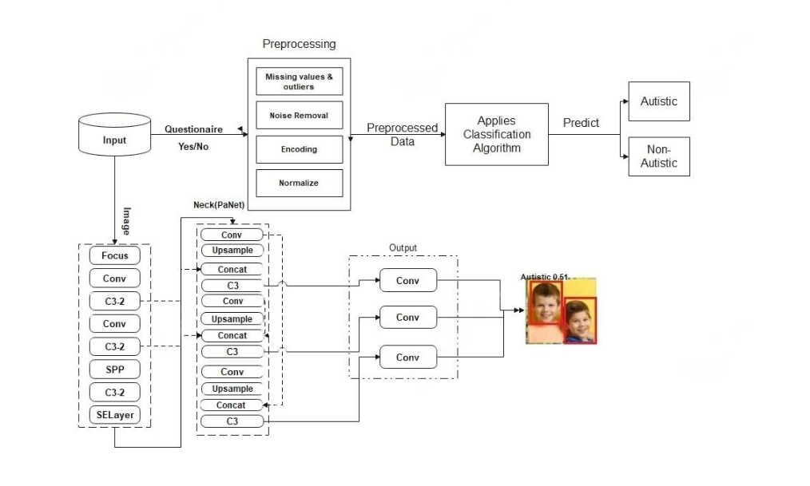
System Architecture

Slide 20
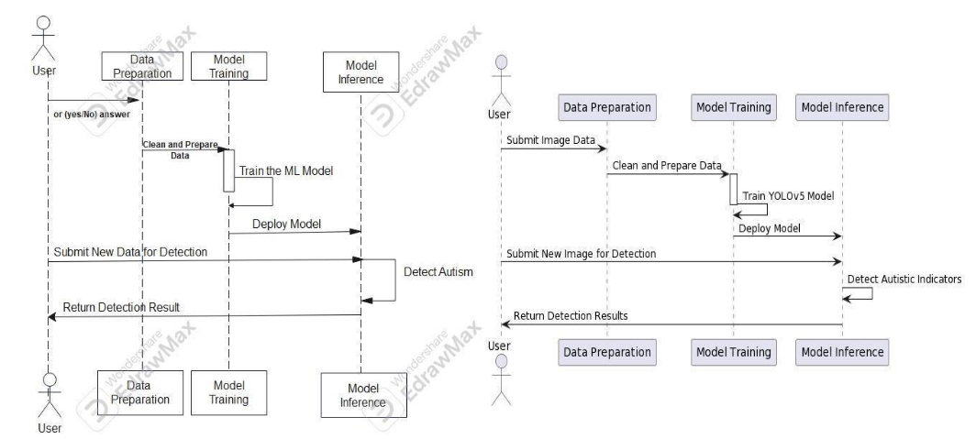
Sequence Diagram

Slide 21
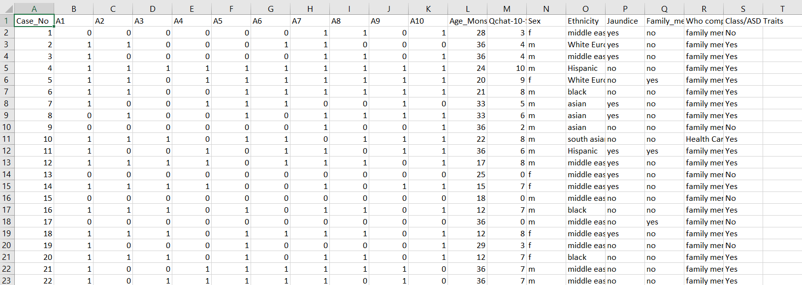
Modules Implemented
Dataset Gathering: Dataset gathering involves the process of collecting, assembling, and organizing a set of data for a specific purpose, such as research, analysis, machine learning, or statistical modeling.

Slide 22
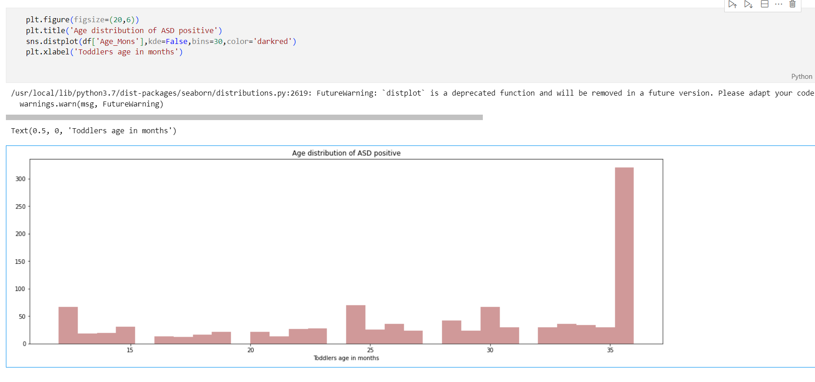
Preprocessing dataset: Preprocessing a dataset is a critical step in preparing the data for analysis or machine learning applications. It involves cleaning, transforming, and organizing the data to enhance its quality and make it suitable for the specific task at hand

Slide 23
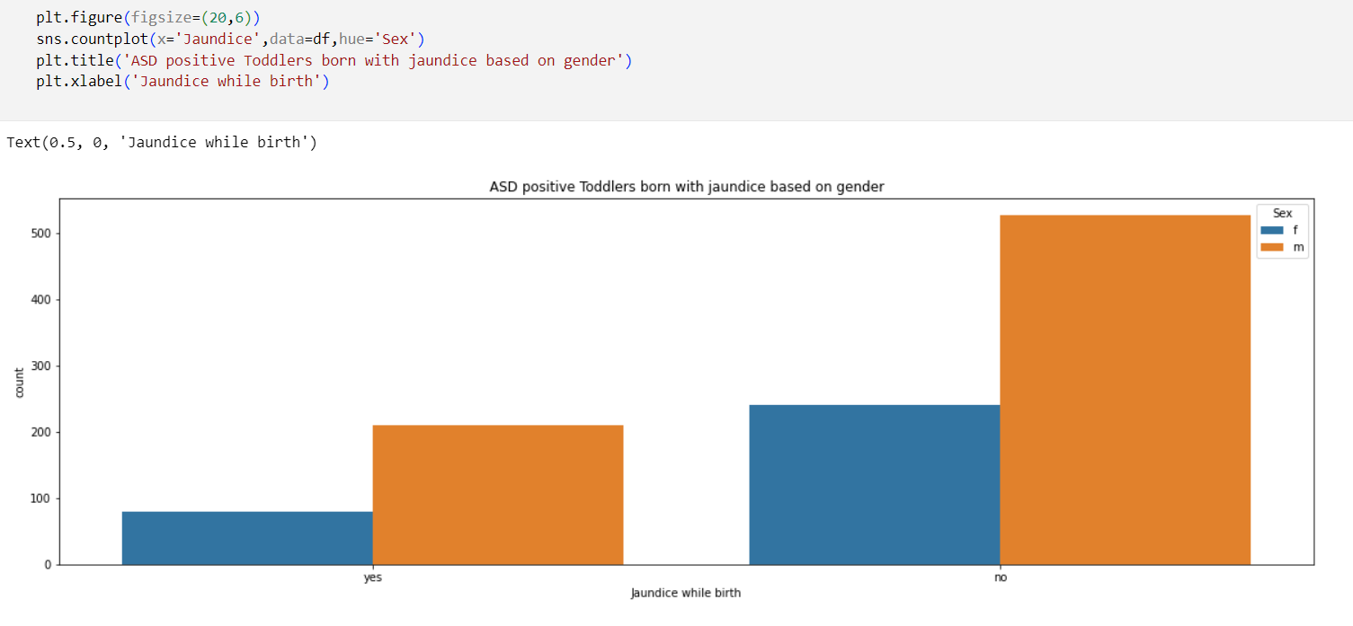

Slide 24
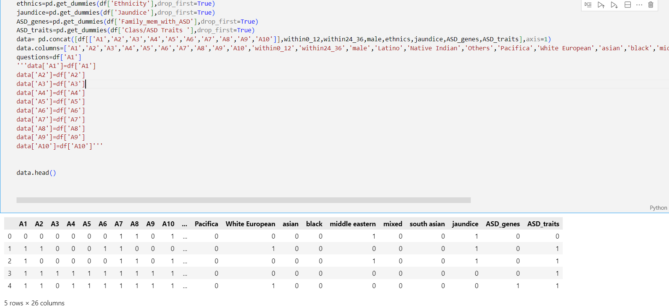
Cleaning the Dataset

Slide 25
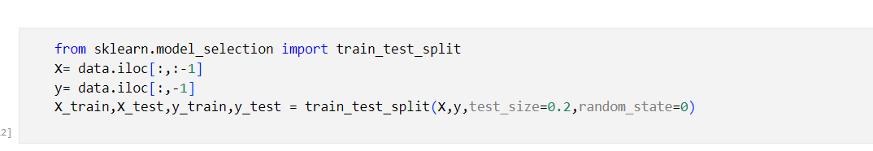
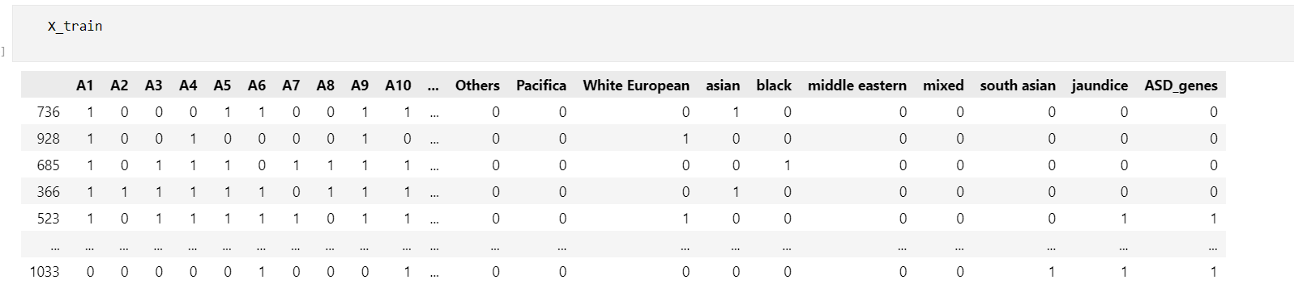
Feature engineering: Create new features or modify existing ones to improve the performance of machine learning models. This may involve combining features, creating interaction terms, or deriving new variables from existing ones.
Splitting the dataset: Split the dataset into training and testing sets. The training set is used to train the model, while the testing set is reserved to evaluate the model's performance on unseen data.

Slide 26
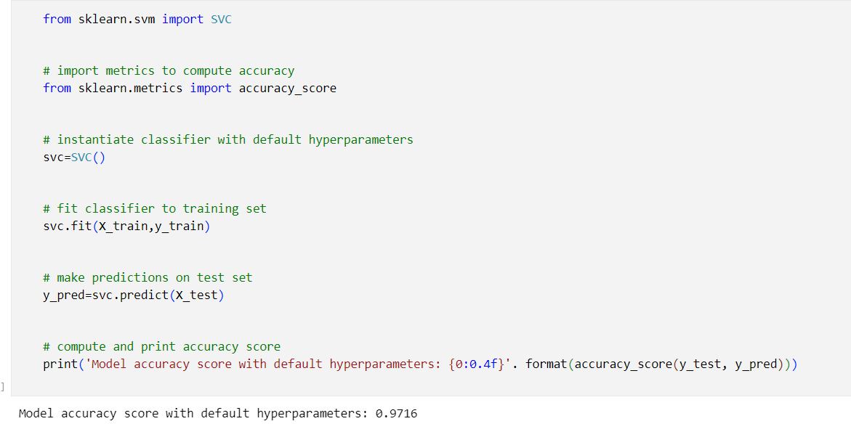
Setting algorithm modules:
Based on your problem type and data characteristics, select a set of candidate algorithms. Common
machine learning algorithms include:

Slide 27
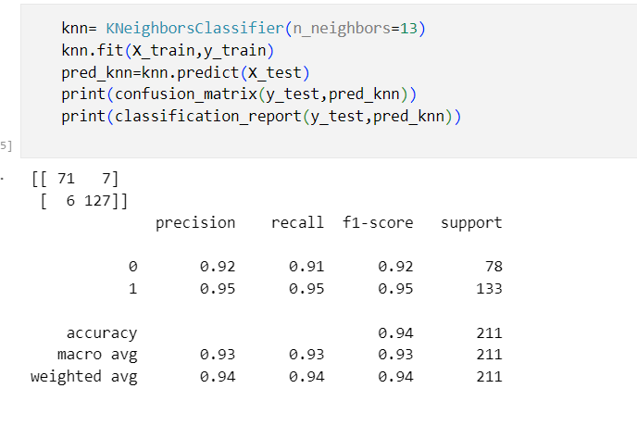

Slide 28
Train model:Train your selected algorithms on the training data using appropriate hyperparameters. Fine-tune these hyperparameters to optimize the model's performance.
Validate model: The validation model is the process to check the system trained model that how the system got trained Checks the accuracy of the system with the percentage of giving right predictions classification with the help of the testing (validation) model.
User Interface Development Module: This module encompasses the creation of user interfaces tailored for healthcare professionals and individuals affected by ASD. It facilitates interaction with the ASD detection system.

Slide 29
MODULES IMPLEMENTED
1. Data Preparation: To train YOLOv5 for person detection, a meticulously labeled dataset is
crucial. This dataset comprises images containing persons, and each person instance must
have corresponding bounding box annotations.
2. Network Architecture: The core of YOLOv5 lies in its Convolutional Neural Network (CNN)
architecture. This neural network processes the entire input image in a single forward pass,
making it highly efficient for real-time object detection.
3. Input Processing: Upon feeding an image into YOLOv5, it is divided into a grid. Each grid
cell is responsible for predicting objects that may reside within its spatial boundaries.

Slide 30
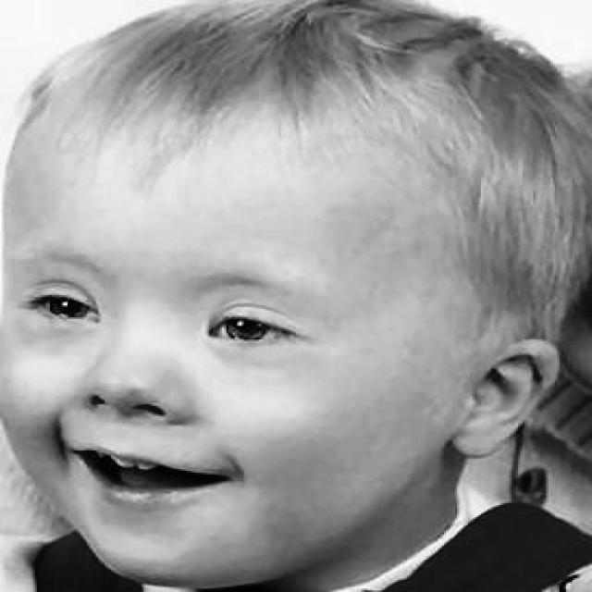
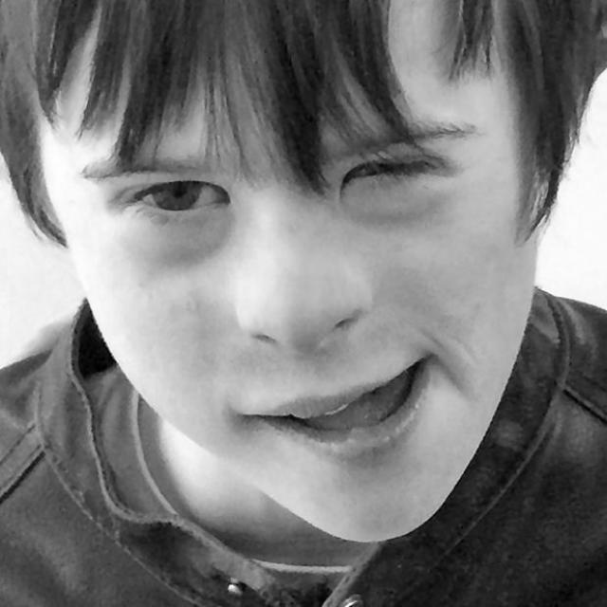
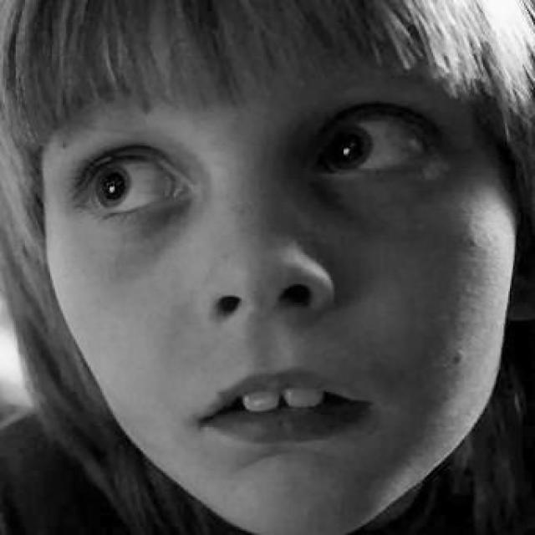
DATASET USED TO TRAIN YOLOv5 MODEL
IMAGES OF CHILDREN WITH AUTISM

Slide 31
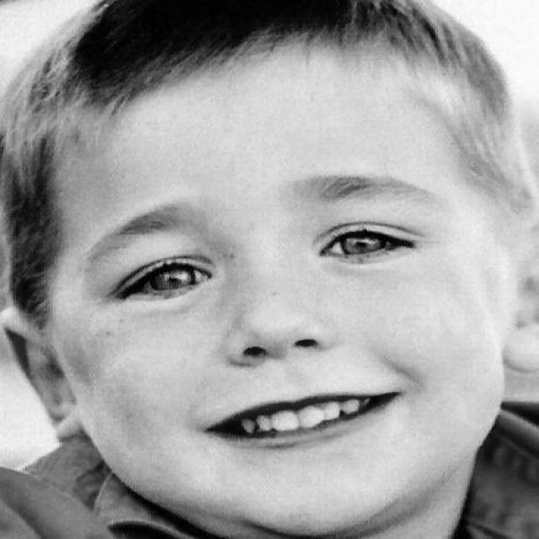
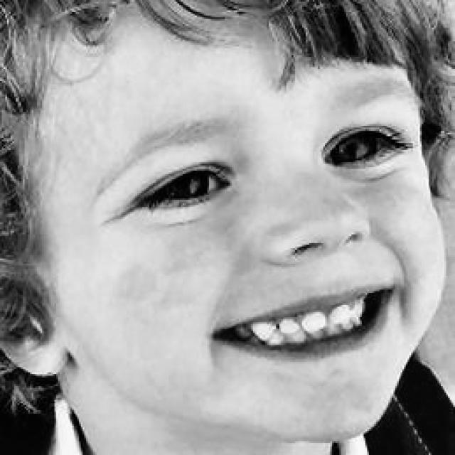
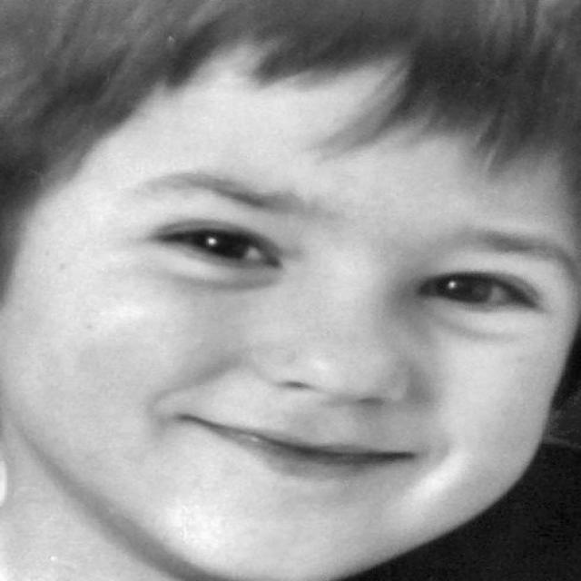
IMAGES OF NON AUTISTIC CHILDREN

Slide 32
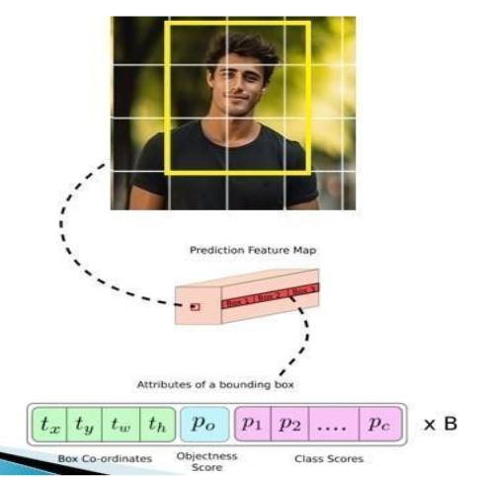

Slide 33
5. Anchor Boxes: Anchor boxes play a pivotal role in refining the accuracy of YOLOv5’s bounding box
predictions. These anchor boxes are learned during the training process, adjusting their dimensions
based on the distribution of object sizes in the dataset.
6. Output Prediction: The predictions generated by YOLOv5 include essential information for each
bounding box: coordinates (x, y) for the box center, width, height, confidencscore, and class
probabilities for each predefined class, such as “Autistic or Non Autistic.“
7. Training: The model undergoes training using the labeled dataset. Backpropagation and optimization
techniques, such as stochastic gradient descent (SGD) or Adam, are applied to iteratively adjust the
model's parameters.

Slide 34
7. Evaluation: The model's performance is rigorously evaluated on a separate
validation set. Metrics such as precision, recall, and mean average precision
(mAP) are calculated to quantitatively assess how well the model generalizes to
new, unseen data

Slide 35
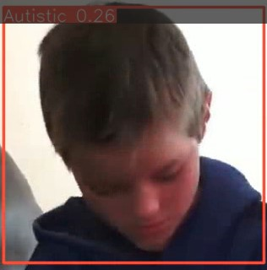
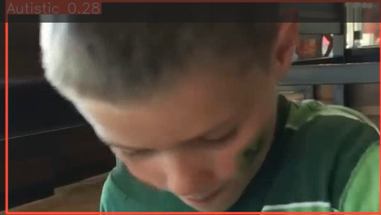
SCREENSHOT OF AUTISM DETECTION THROUGH YOLOV5 MODEL

Slide 36

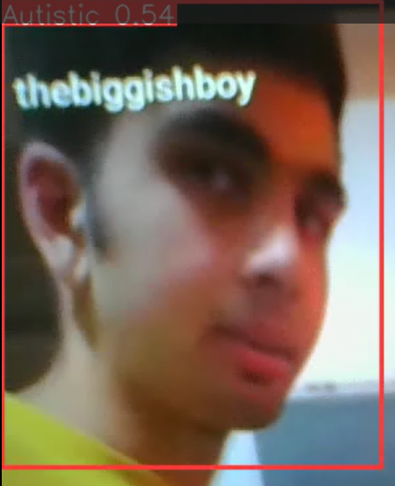

Slide 37
References
Autism Assistant: A Platform for Autism Home-Based Therapeutic Intervention by Mihaela Chistol, Cristina Turcu And Mirela Danubianu from IEEE-2023
A Multimodal Approach for Identifying Autism Spectrum Disorders in Children by Junxia Han, Guoqian Jiang , Member, IEEE, Gaoxiang Ouyang , Member, IEEE, And Xiaoli Li from IEEE-2022
Automatic Identification of High-Risk Autism Spectrum Disorder: A Feasibility Study Using Video and Audio Data Under the Still-Face Paradigm by Chuangao Tang , Student Member, IEEE, Wenming Zheng , Senior Member, IEEE, Yuan Zong , Member, IEEE, Nana Qiu, Cheng Lu , Xilei Zhang, Xiaoyan Ke, and Cuntai Guan , Fellow, IEEE from IEEE-2020
Predicting the Symptom Severity in Autism Spectrum Disorder Based on EEG Metrics by Yangsong Zhang , Shu Zhang, Baodan Chen from IEEE-2022
Computer Aided Autism Diagnosis Using Diffusion Tensor Imaging by Yaser A. Elnakieb , Mohamed T. Ali, Ahmed Soliman ,Ali H. Mahmoud from IEEE-2020

Slide 38

THANK YOU

